Slide 1

Healthy Eating
Gail Mayer, MS, RD, CDN

Slide 3

89% of our Diet from
Processed Food & Animal
Food
Excess Weight
Health Problems
Diabetes
Heart Attack
Stroke
Cancer

Slide 4

It’s Not Your Fault!
Food companies make their food addictive on purpose!

Slide 5
Eat More Whole Plant Foods
Research Shows Plant Foods Help You:
  Lose Weight
  Reverse Diabetes, Pre-diabetes
  Lower Blood Pressure
  Lower Cholesterol
  Reverse Heart Disease
  Prevent Heart Attack, Stroke
  More Energy
  Better Mood
Eat Less Processed
and Animal Foods

Slide 6
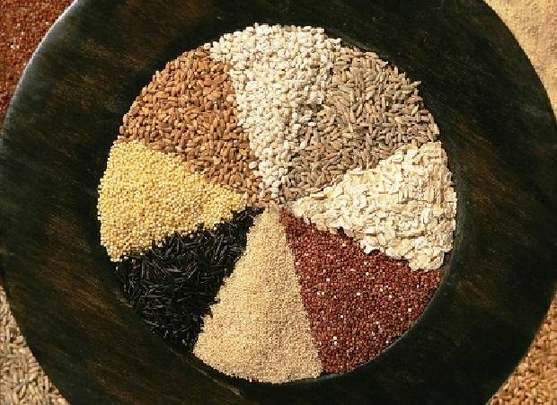
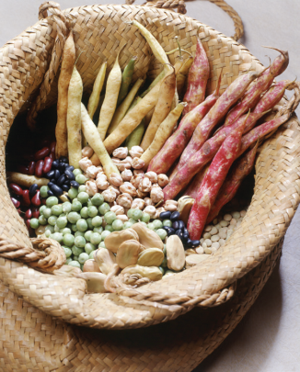
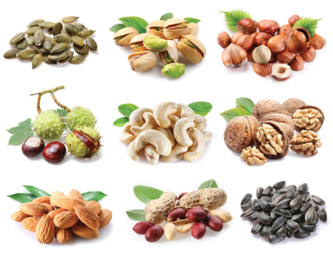


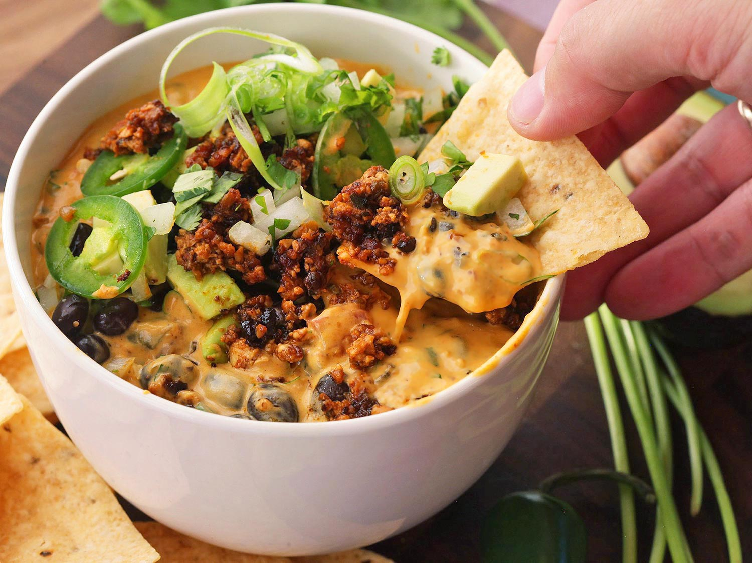
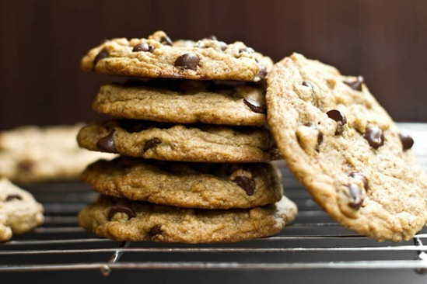

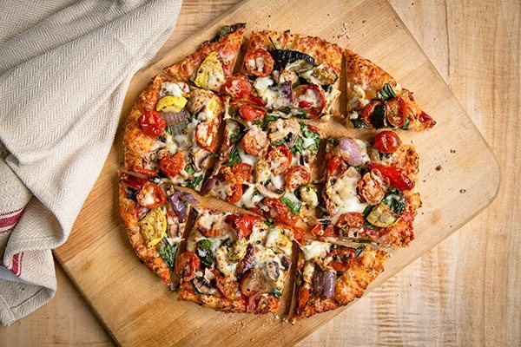
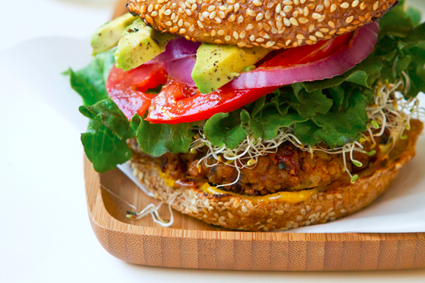
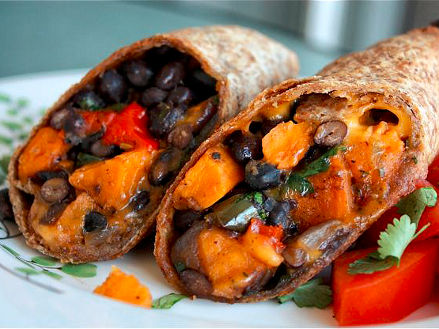
Eat Whole Plant Foods
Vegetables & Fruits
Grains
Legumes
Nuts & Seeds
Notes:
Vegans only eat foods that come from plants. The formal definition of a vegan, by the main who coined it, Donald Watson, is: The word "veganism“ denotes a philosophy and way of living which seeks to exclude — as far as is possible and practical — all forms of exploitation of, and cruelty to, animals for food, clothing or any other purpose; and by extension, promotes the development and use of animal-free alternatives for the benefit of humans, animals and the environment. In dietary terms it denotes the practice of dispensing with all products derived wholly or partly from animals.

Slide 7
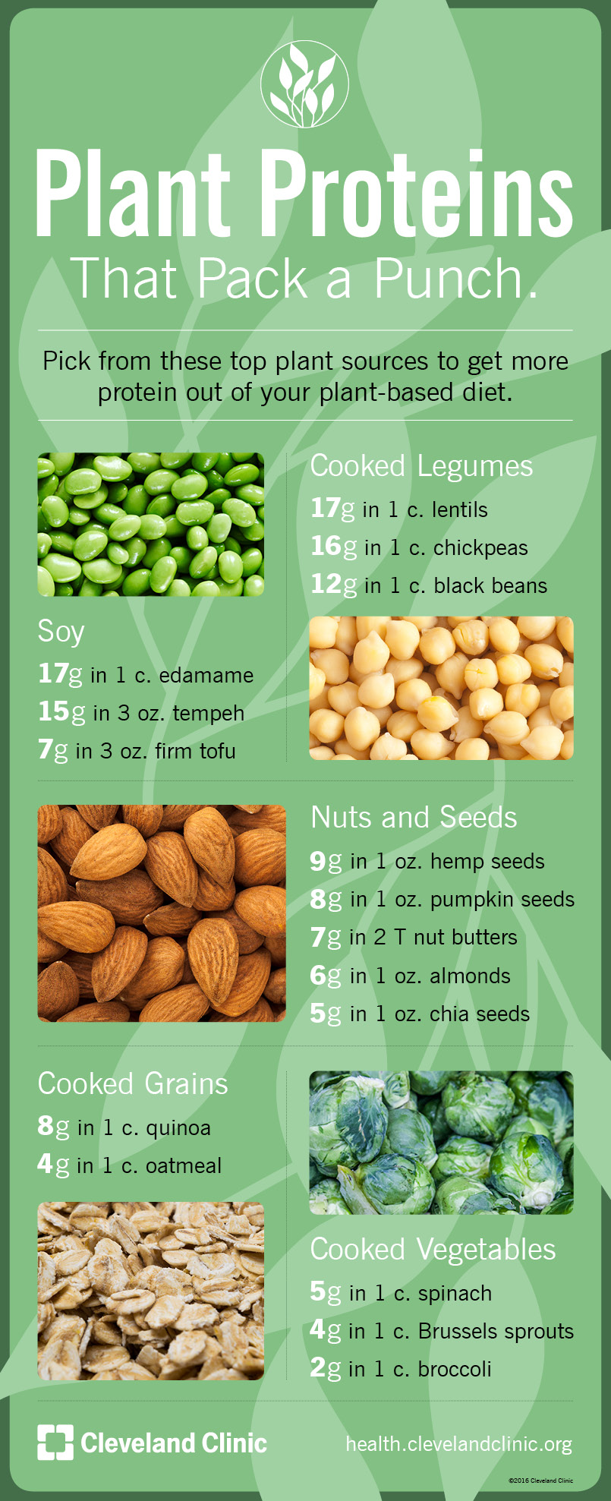
Protein from Plants!?!

Slide 8
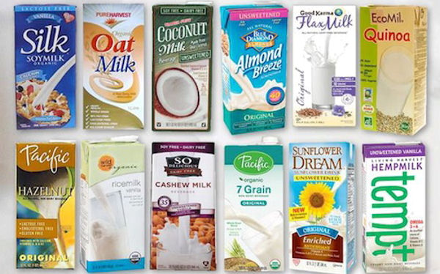
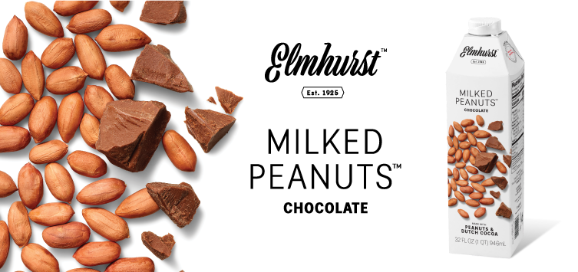
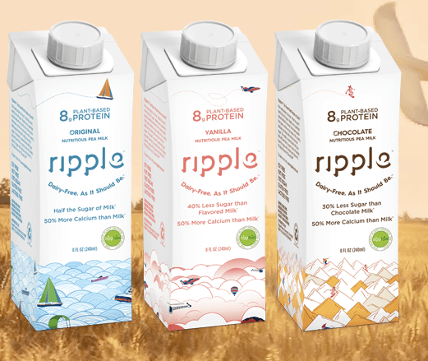
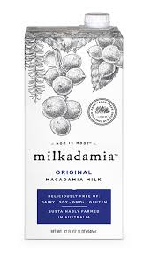
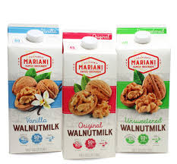

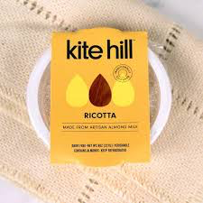

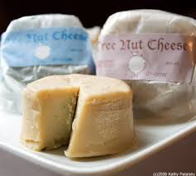
Plant Milks
Nut-Based Cheese

Slide 9
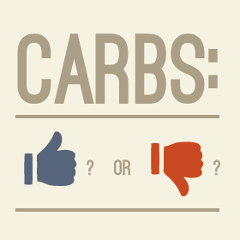
Carbs are Good!?!
Carb Confusion
Healthy Carbs have FIBER!
Unhealthy Carbs Have
NO Fiber
Macronutrient myths - carbs
Fruits
Vegetables
White Sugar
Grains
Beans
White Flour
Nuts
Seeds
(Processed)
(Unprocessed)

Slide 10
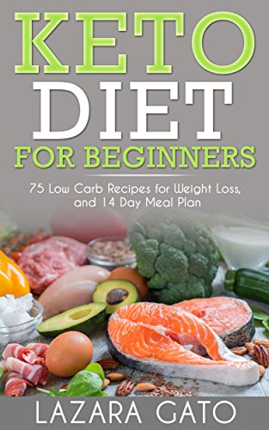
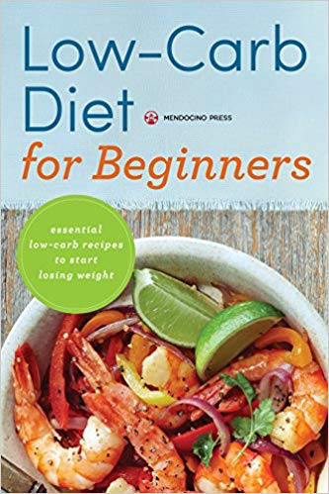

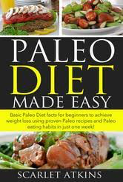

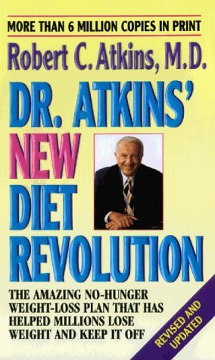

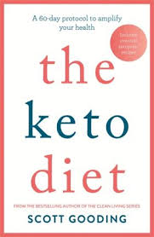
What about Low Carb Diets?
- Fad diets make money
by confusing and
misleading people
- Not based on research
- Long-term health risks

Slide 11

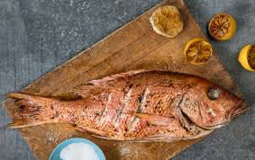
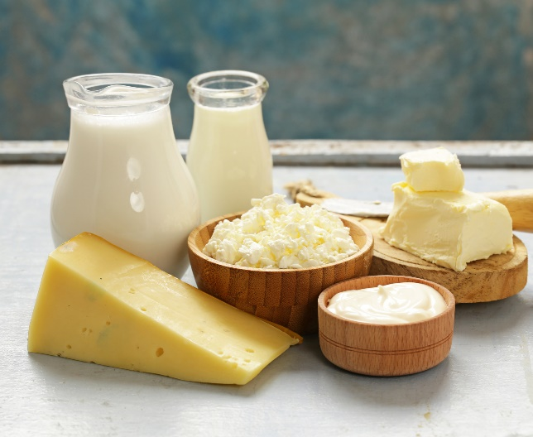
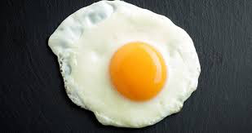
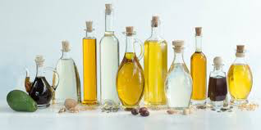
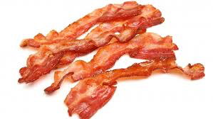

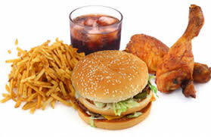
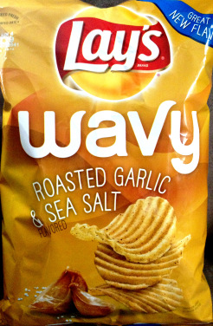


Avoid Foods That Cause Disease

Slide 12
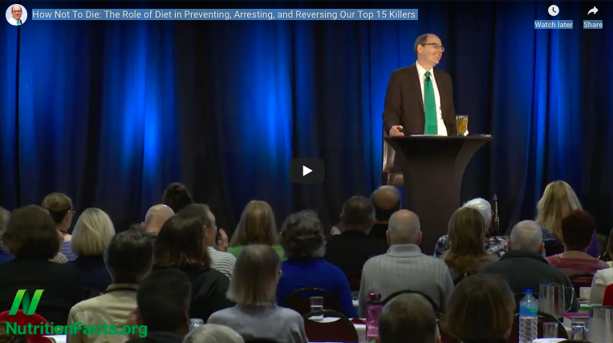
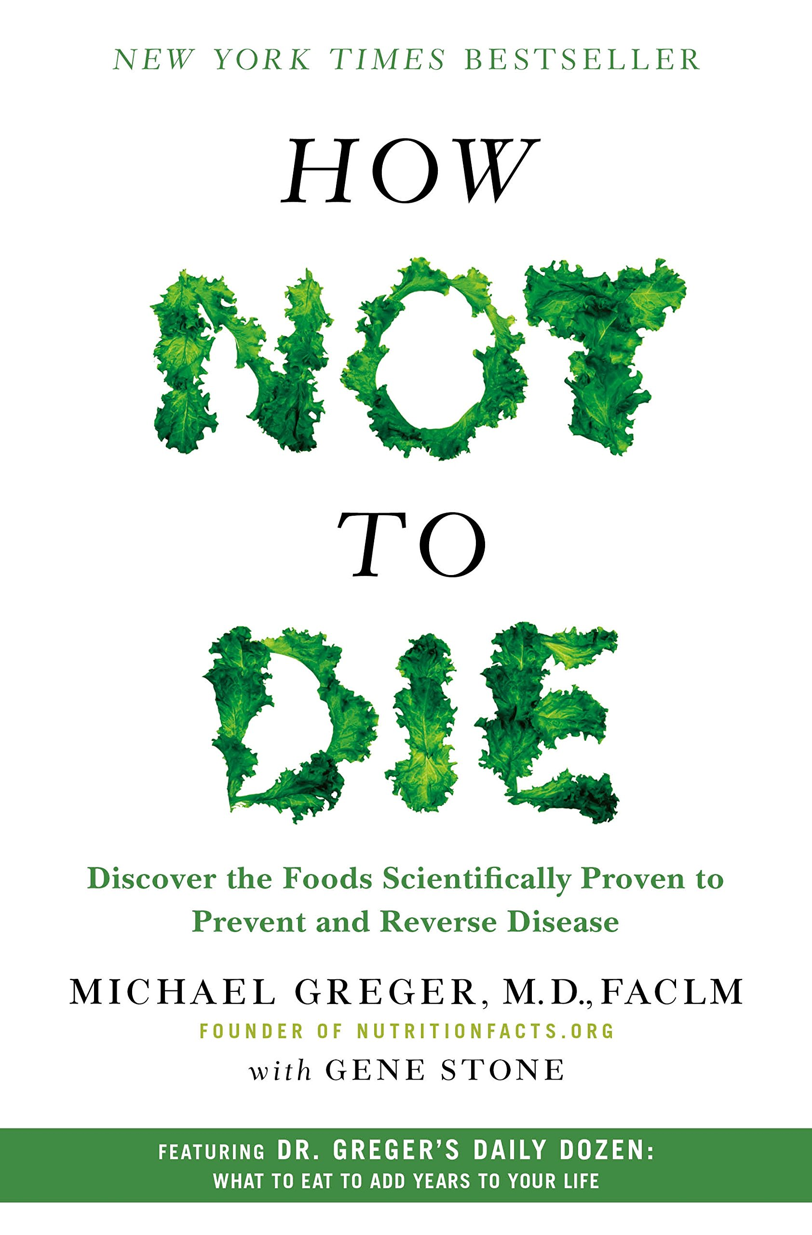

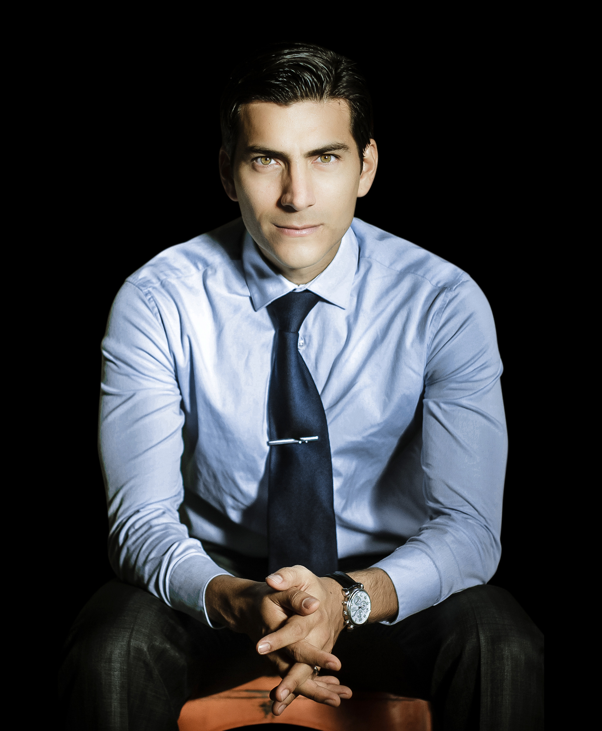
More Info
nutritionfacts.org/video/how-not-to-die/
DrMauricioGonzalez.com
Netflix

